Slide 1
Program
MineOperate Technical Level 1
Working with LP Panels
Edgar Sepulveda
Global Technical Manager, MineOperate
10/10/2022
Version 1.3

Slide 2

Purpose
This session …
​At the end of this module, you will:

Slide 3
Working with LP Panels
LP Panels
Fleet Management Field Equipment | Fleet Management Office | Machine Guidance | Machine & Asset Health
LP Truck | OP Pro Manager | HP Shovel | Asset Health
LP Shovel | Jview | HP Loader
LP Loader |  | HP Drill
LP Drill |  | HP Dozer
LP Dozer
LP Grader
LP Water Truck
LP Fuel Truck
LP Supervisor

Slide 4
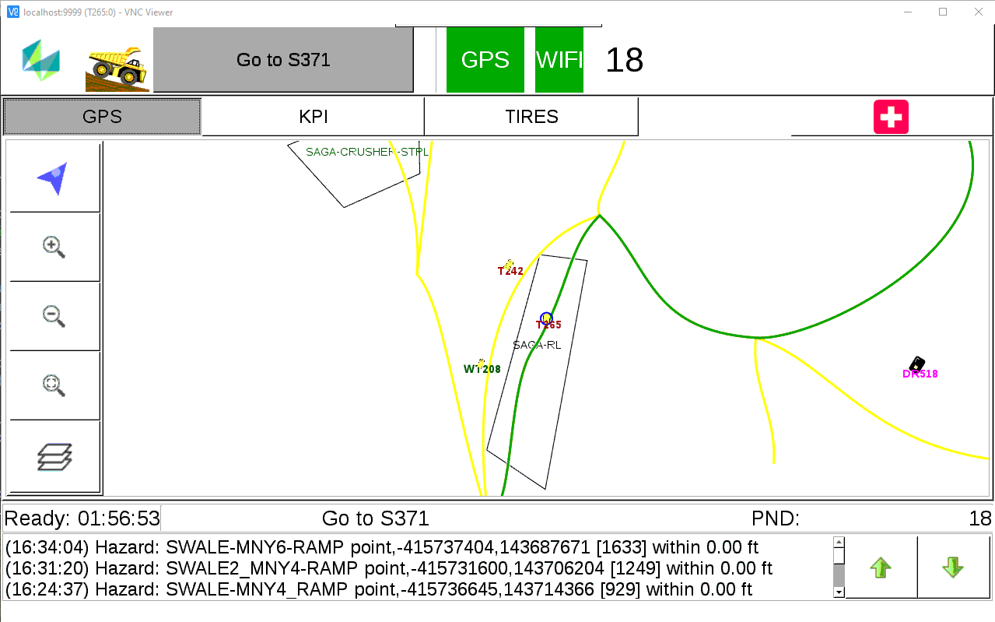
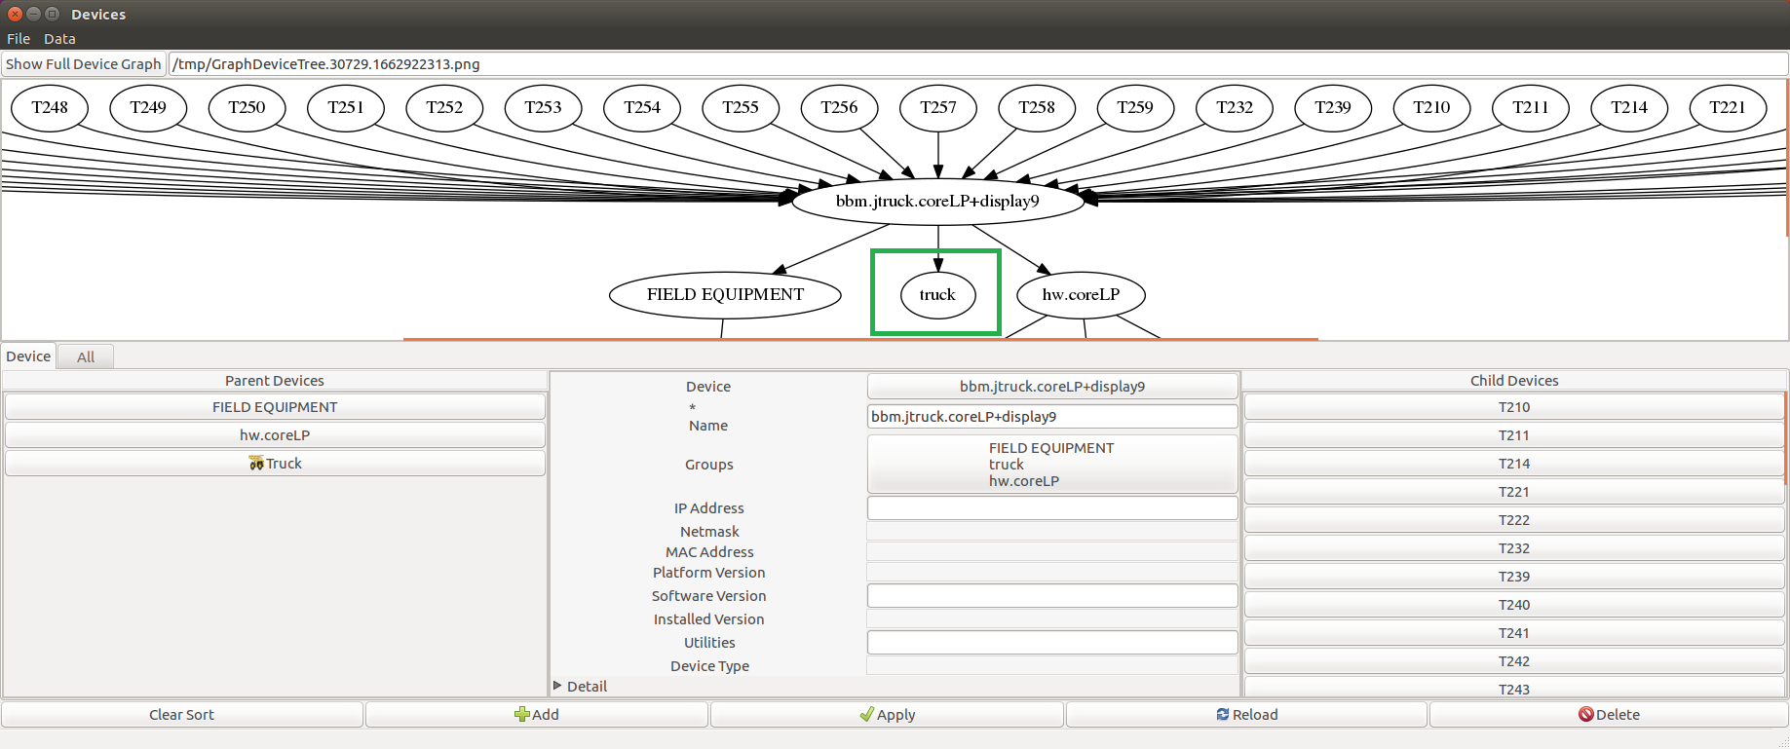
Working with LP Panels
Panel configuration

Slide 5
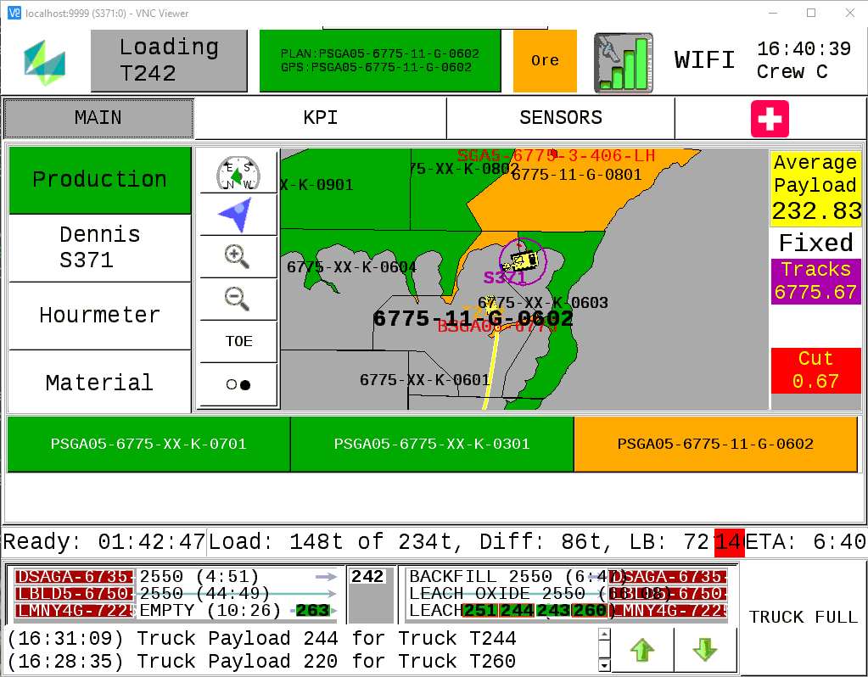
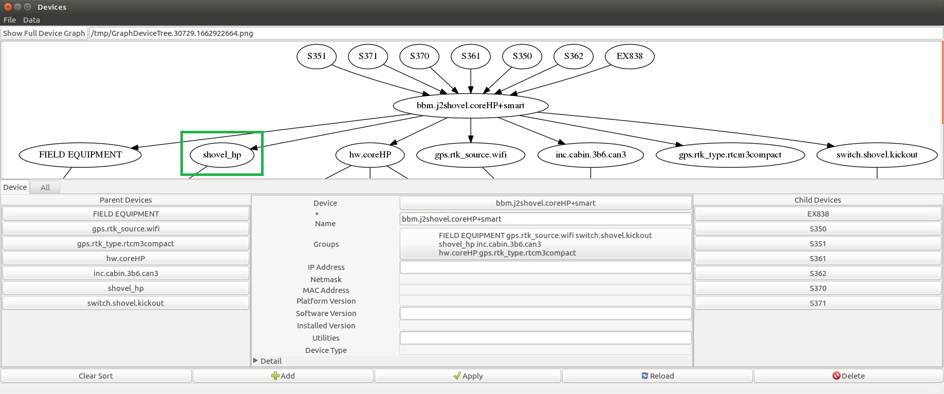
Working with LP Panels
Panel configuration

Slide 6
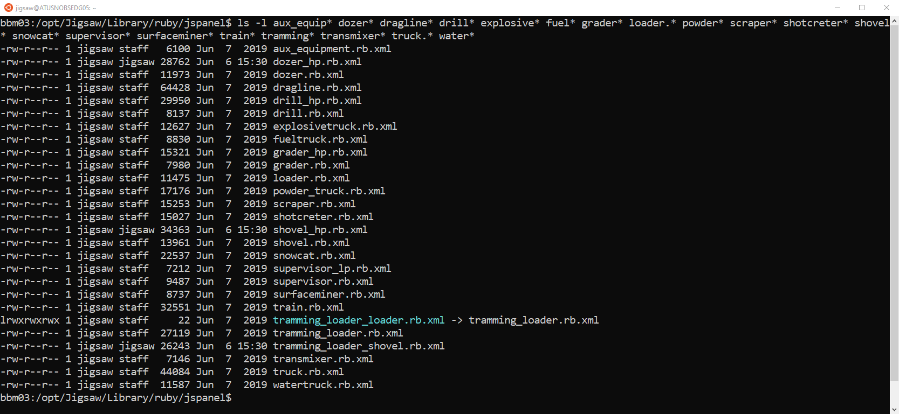
Working with LP Panels
Panel configuration

Slide 7
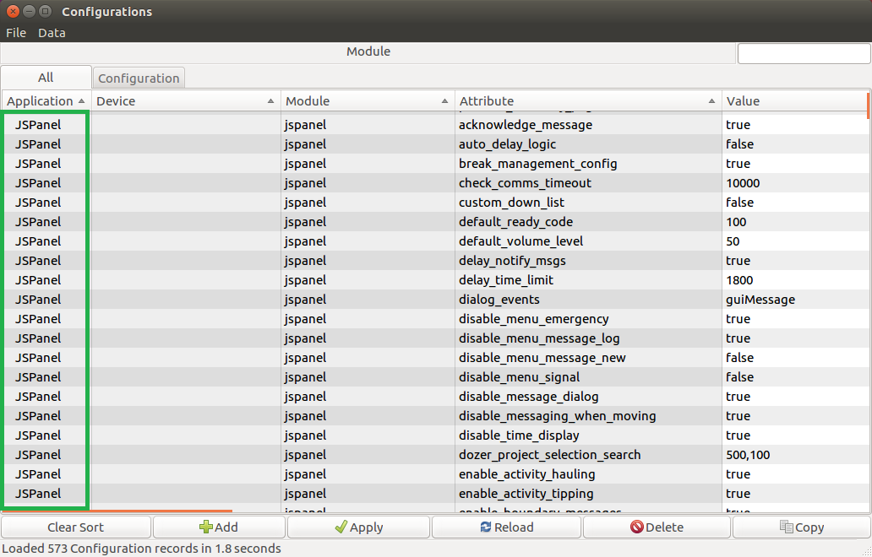
Working with LP Panels
Panel configurations

Slide 8
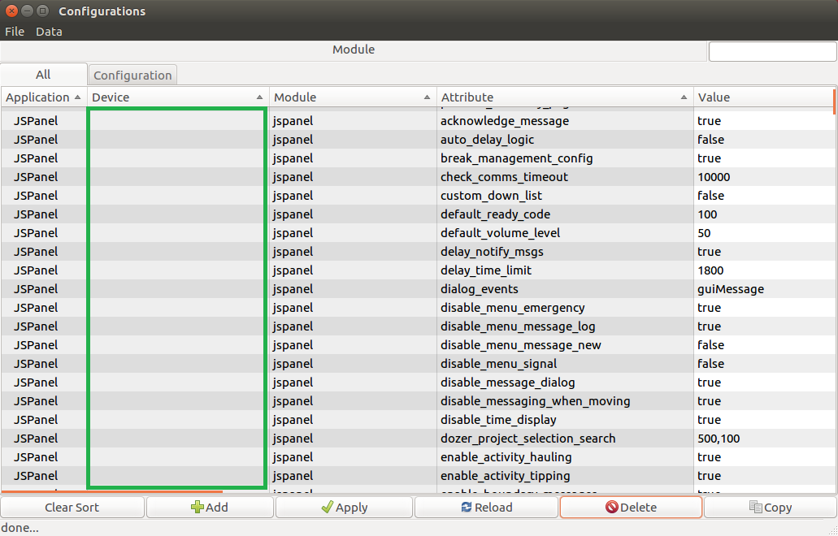
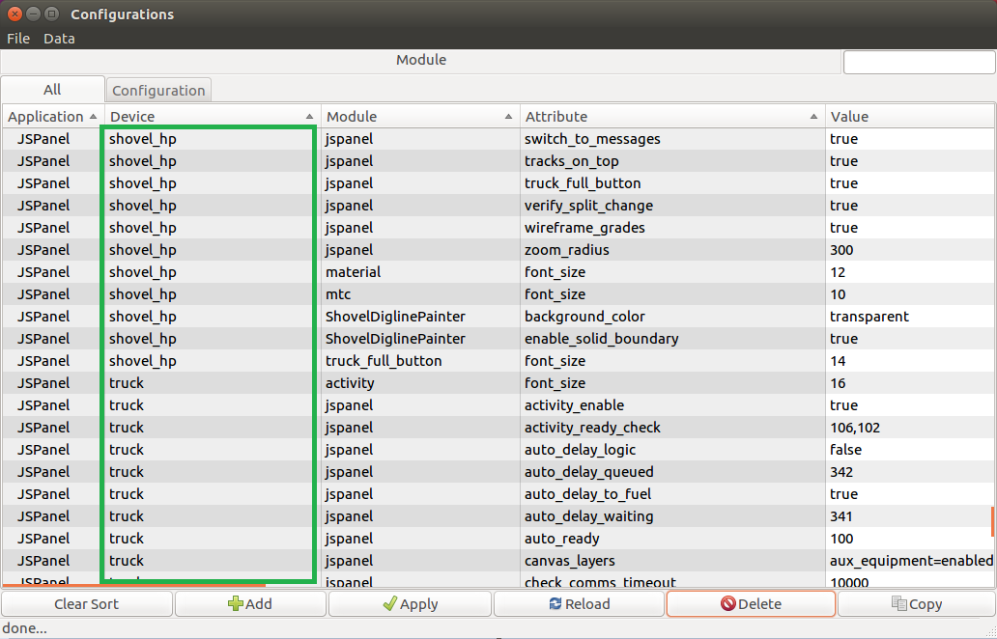
Working with LP Panels
Panel configurations

Slide 9
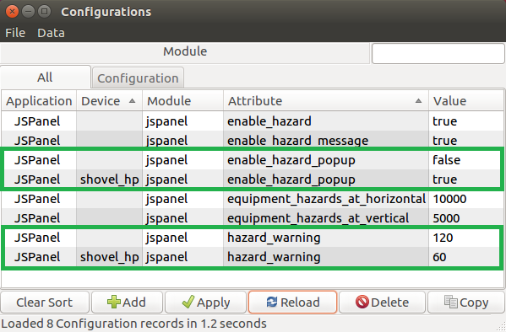
Working with LP Panels
Panel configurations

Slide 10
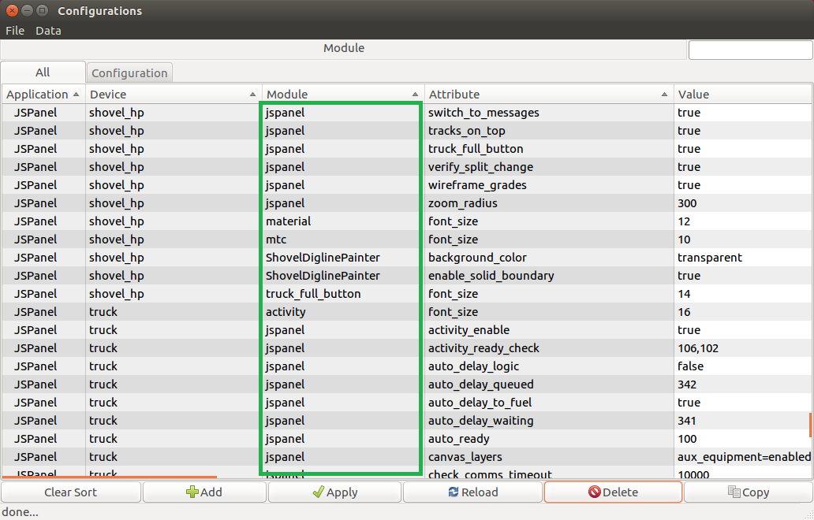
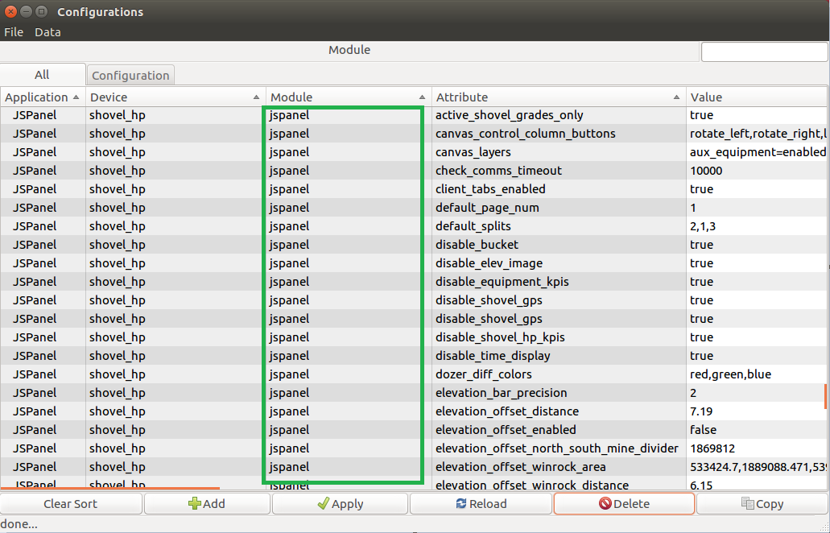
Working with LP Panels
Panel configurations

Slide 11
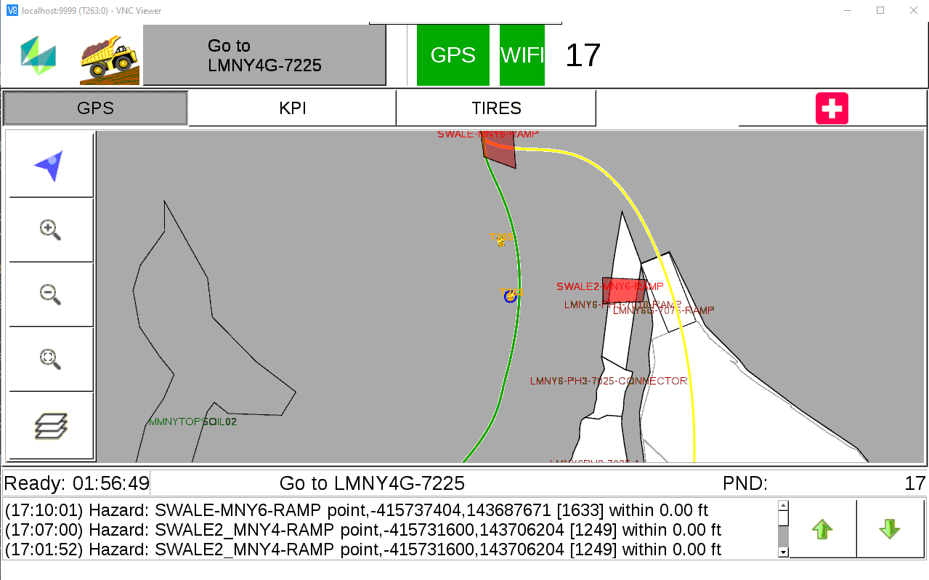
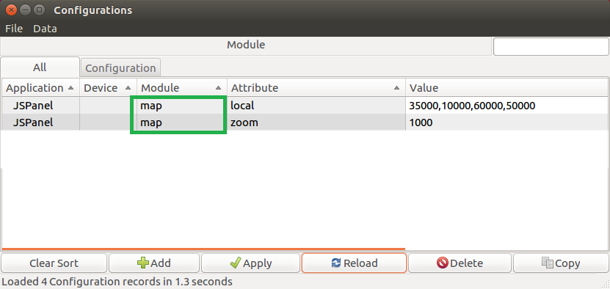
Working with LP Panels
Panel map configurations

Slide 12
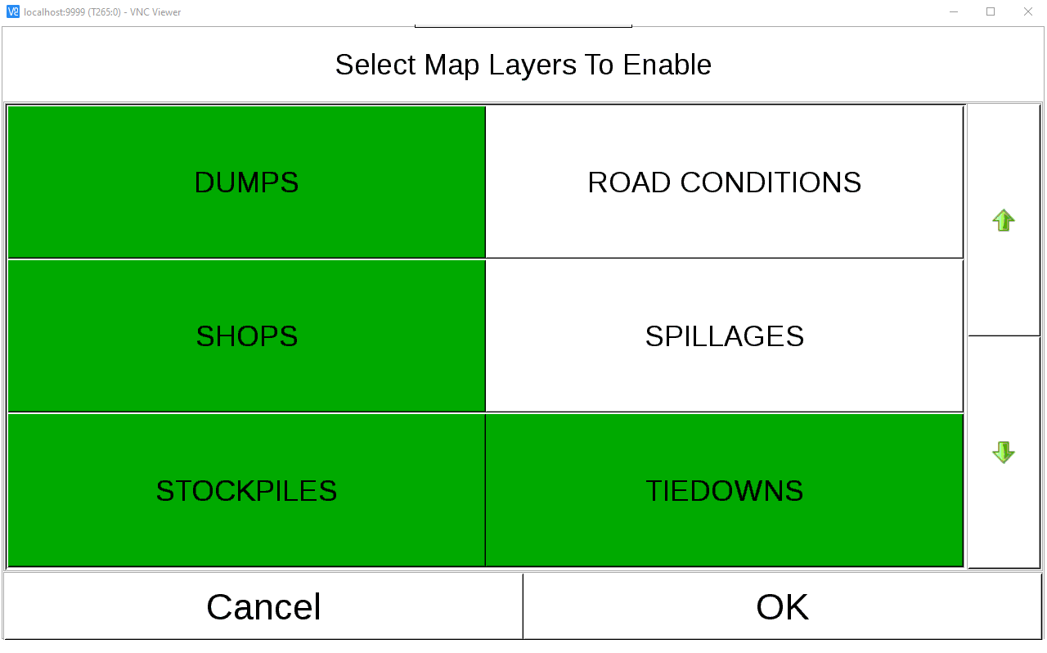
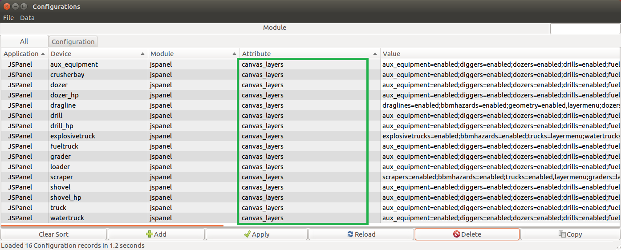
Working with LP Panels
Panel map layers configurations

Slide 13
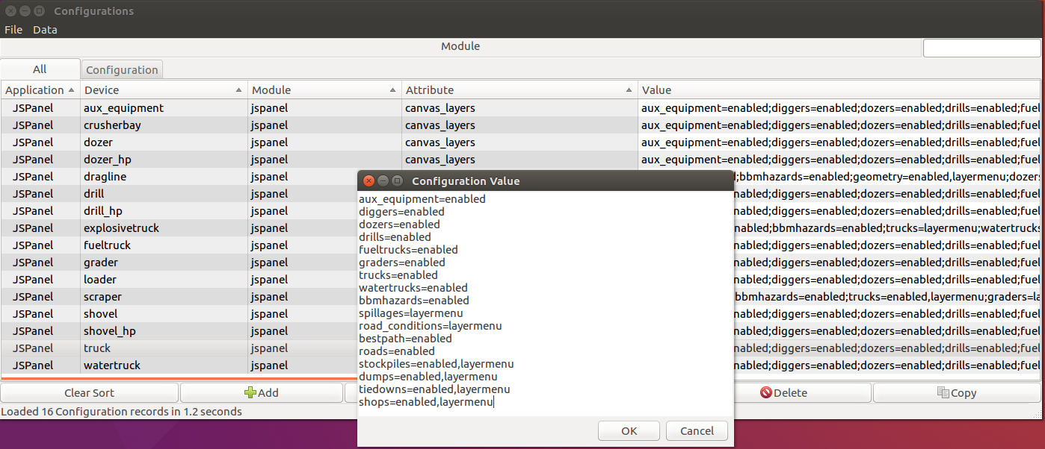
Working with LP Panels
Panel map layers configurations

Slide 14
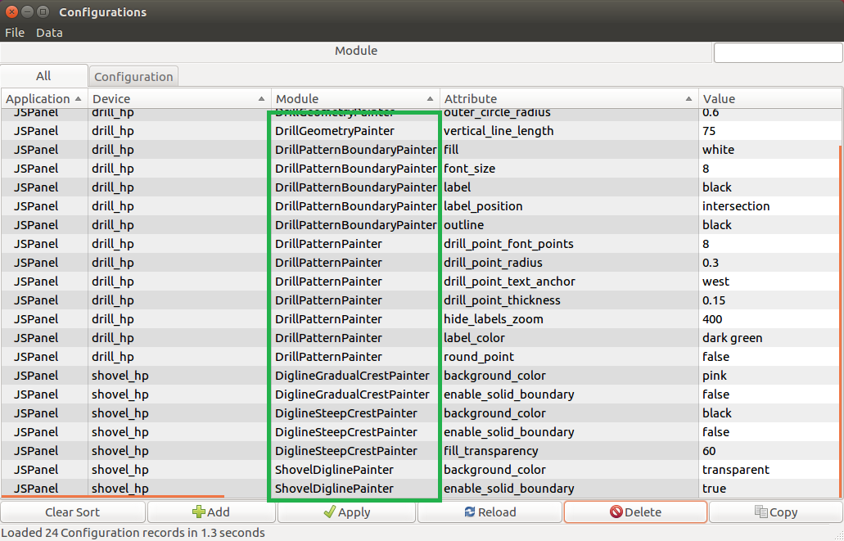
Working with LP Panels
Panel painter configurations

Slide 15
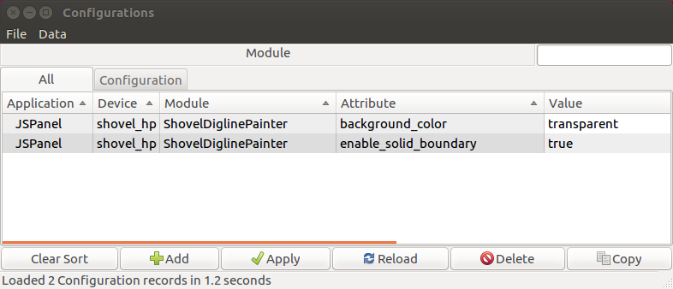
Working with LP Panels
Panel painter configurations

Slide 16
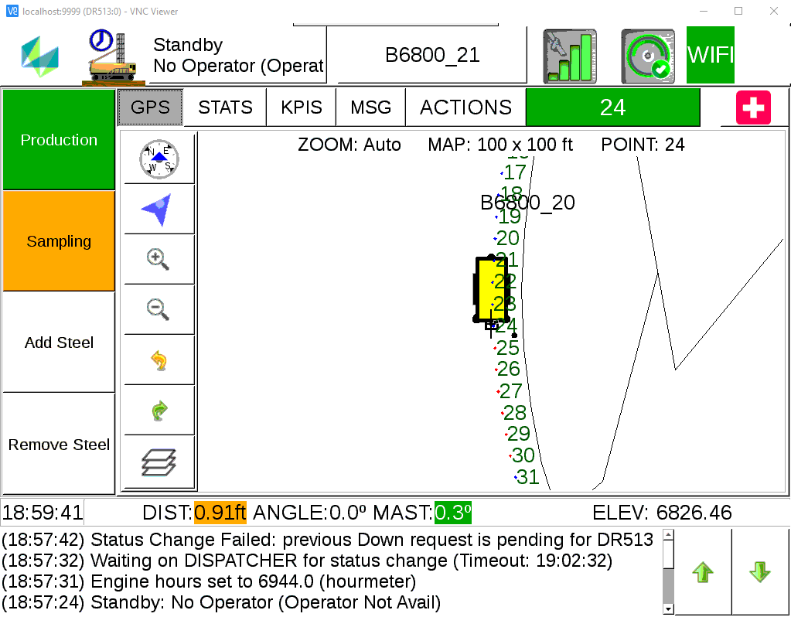
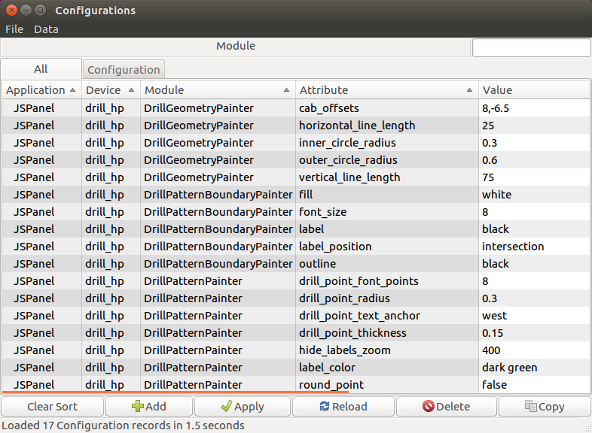
Working with LP Panels
Panel painter configurations

Slide 17
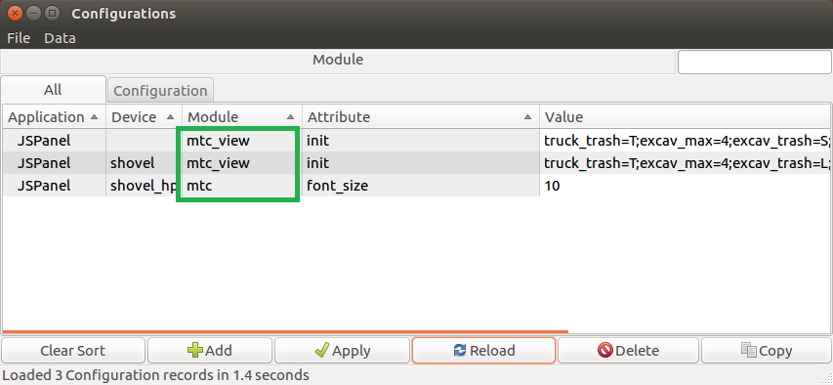
Working with LP Panels
Panel MTC configurations

Slide 18
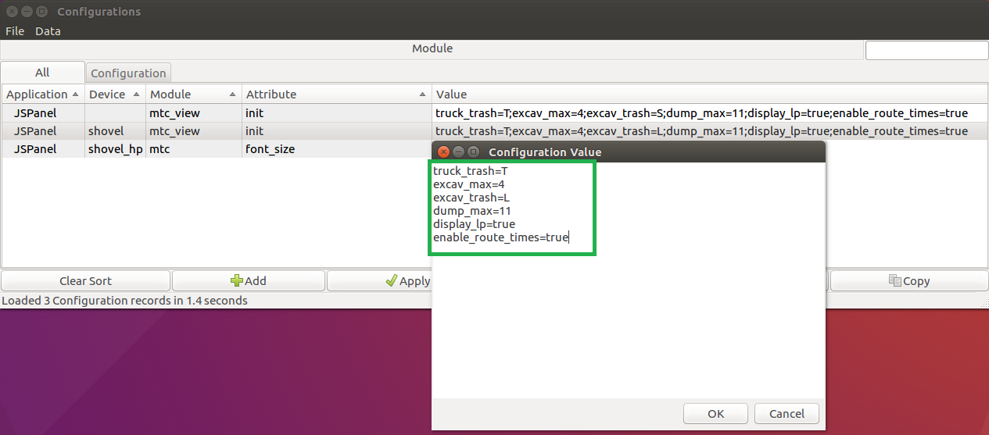
Working with LP Panels
Panel MTC configurations

Slide 19
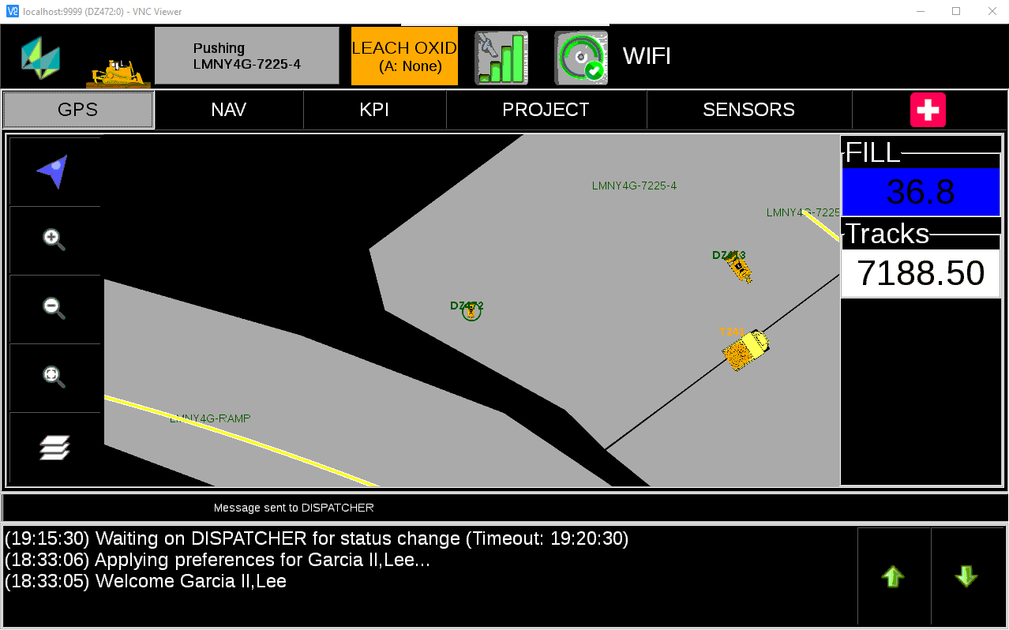
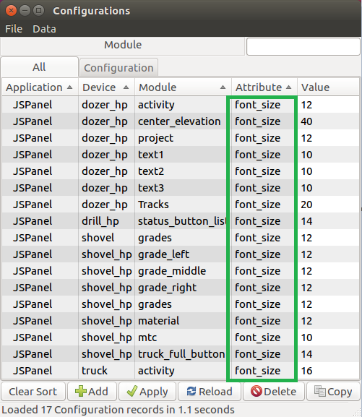
Working with LP Panels
Panel font configurations

Slide 20
Working with LP Panels - Questions

Slide 21
Working with LP Panels - Answers to Questions

Slide 22

THANK
Y
O
U

